Slide 1

TEAM MEMBERS
Kamal Garg 21103231 B9
Srishti Garg 21103227 B9
Rhythm Srivastava 21103234 B9
Divya 21103233 B9

Slide 2
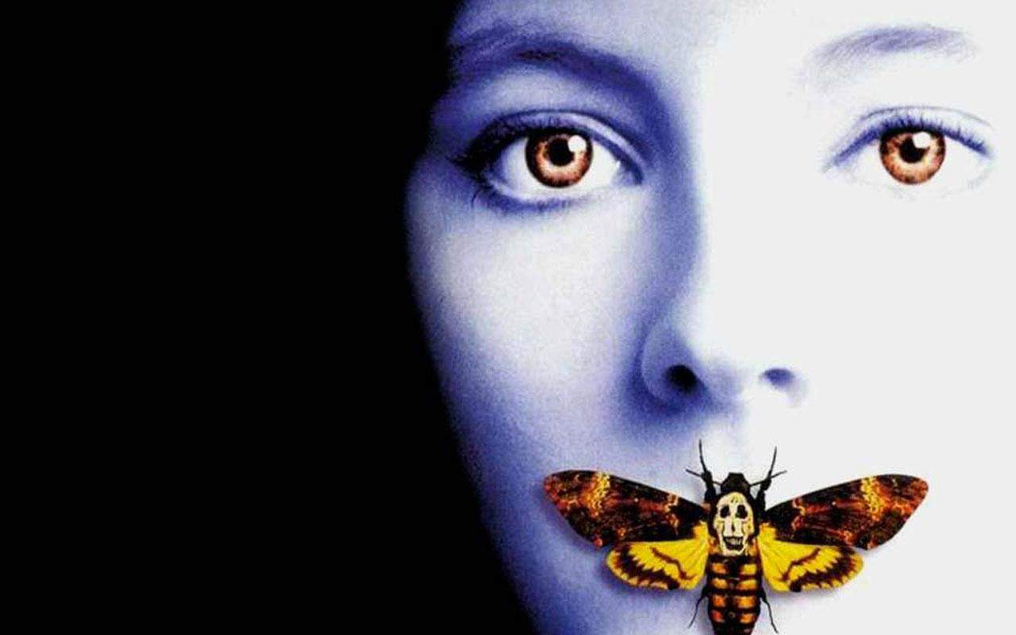
# Me Too Movement
The Silence Breaker

Slide 3
WHAT IS ME TOO ?
#MeToo is a social movement against sexual abuse and sexual harassment where people publicize allegations of sex crimes particularly on work place.
This term was coined by sexual assault survivor and activist Tarana Burke in 2006.

Slide 4
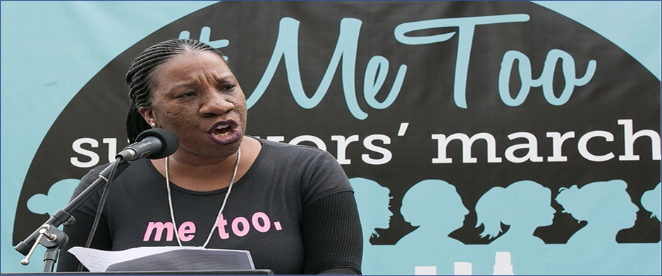
WHERE IT CAME FROM
In 2006, Tarana Burke founded the Me Too movement and began using the phrase "Me Too" to raise awareness of the pervasiveness of sexual abuse and assault in society.
Tarana Burke, An American Social Activist And Community Organizer

Slide 5
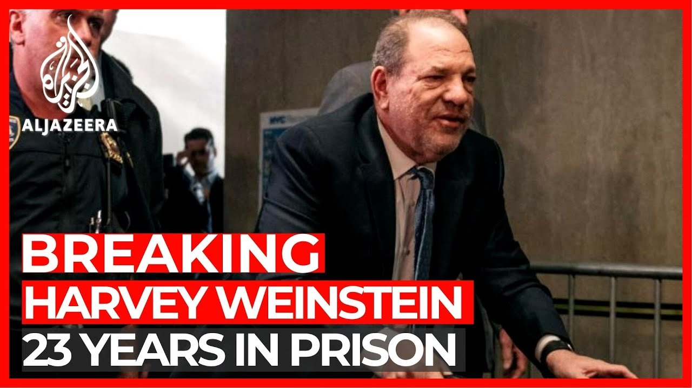
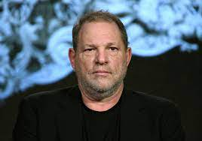
HOW IT STARTED
Alyssa Milano states that while filming "Who's the Boss", she was sexually abused by a man 17 years older than her. Later in 2017 she through her tweet on MeToo she revealed that man was Harvey Weinstein.

Slide 6
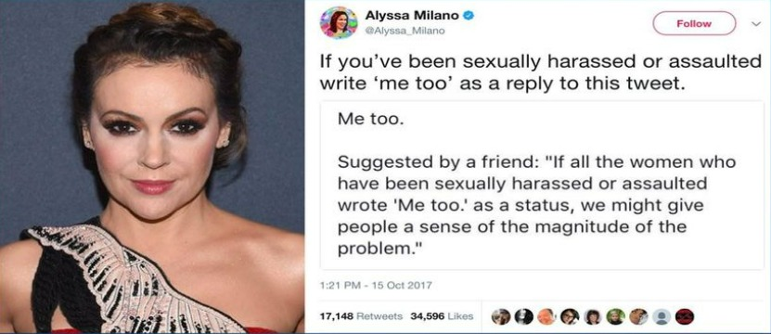
WITH A TWEET ALL STARTED
This tweet has been retweeted over half a million times in 24 hours and the hashtag was used by over 4.7 million people in the first 24 hours.

Slide 7
HOW ME TOO HITS INDIA?
Me Too gathered sharp momentum in India in October 2018 in the entertainment industry of Bollywood, centered in Mumbai, when actress Tanushree Dutta on October 7, 2018 accused Nana Patekar of sexual harassment.
What began as one woman's story soon became a phenomenon when the names of powerful men in the country started surfacing. From actor Alok Nath to journalist and politician MJ Akbar, the movement has brought to light many stories of sexual harassment and abuse.

Slide 8
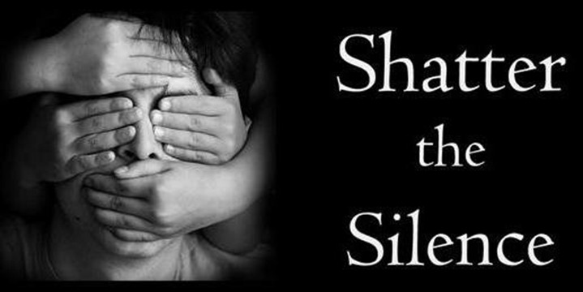

Slide 9
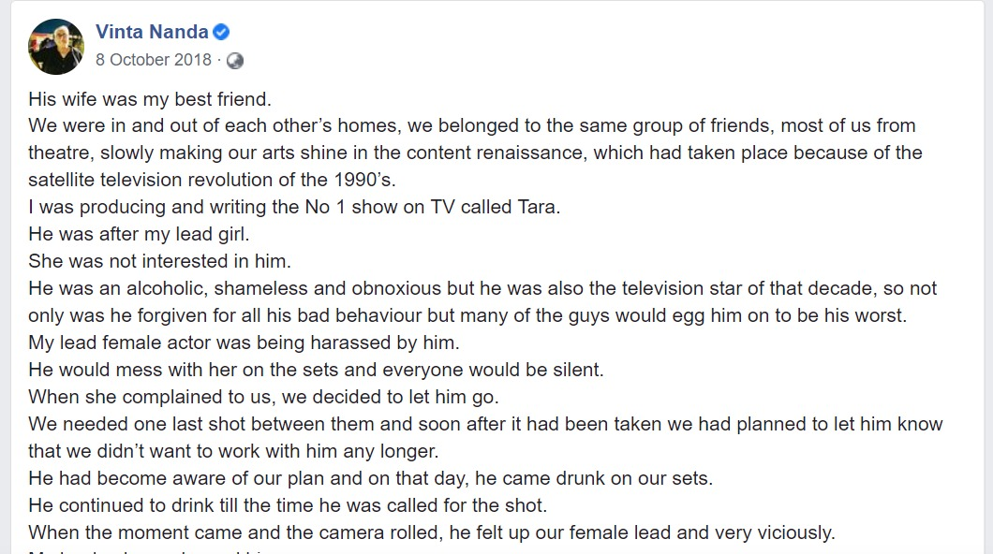
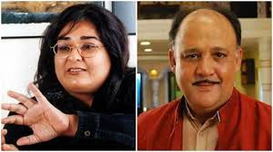
ME TOO SURVIVORS
Alok Nath, who is famous for 'sanskaari' roles, has been accused of rape by filmmaker and writer Vinta Nanda. She posted about the incident on her Facebook page on October 8. She has alleged that Nath raped her more than once 19 years ago.

Slide 10
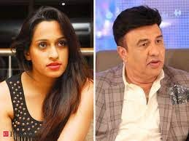
ME TOO SURVIVORS
On 17 October, singer Shweta Pandit accused the National Award-winning composer Anu Malik of asking her for a kiss in exchange for work when she was 15 years old back in 2001, soon after she debuted in Bollywood as a playback singer with Mohabbatein.

Slide 11
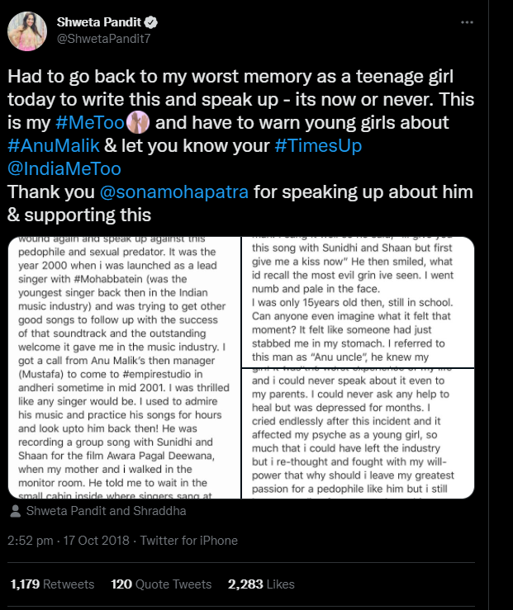

Slide 12
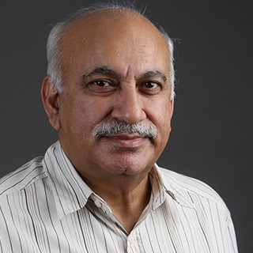
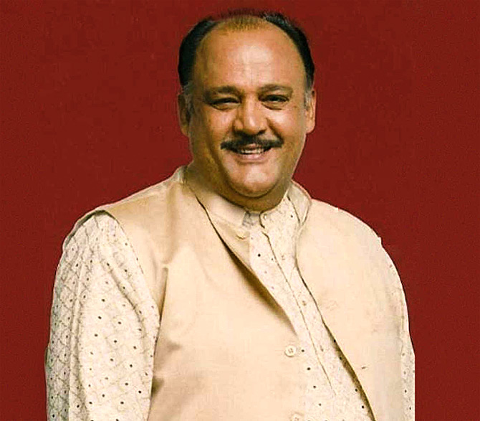
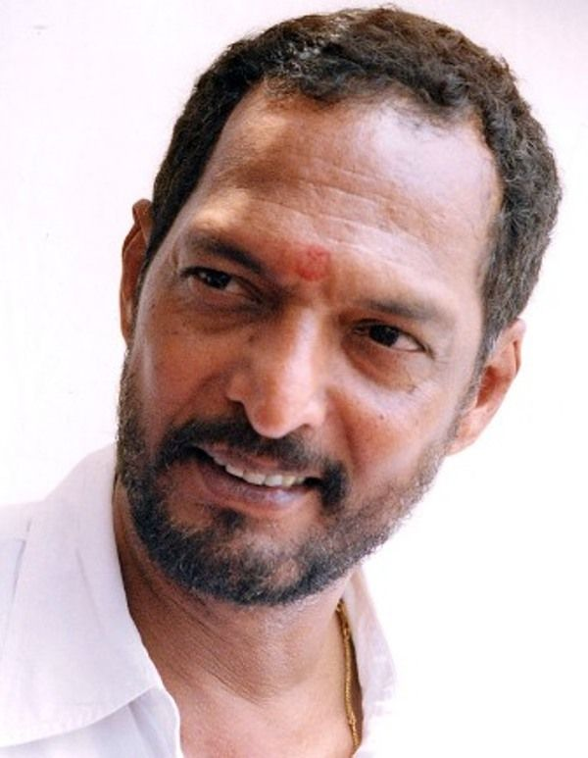
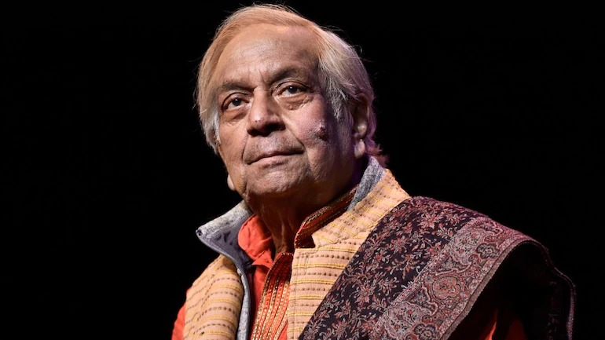
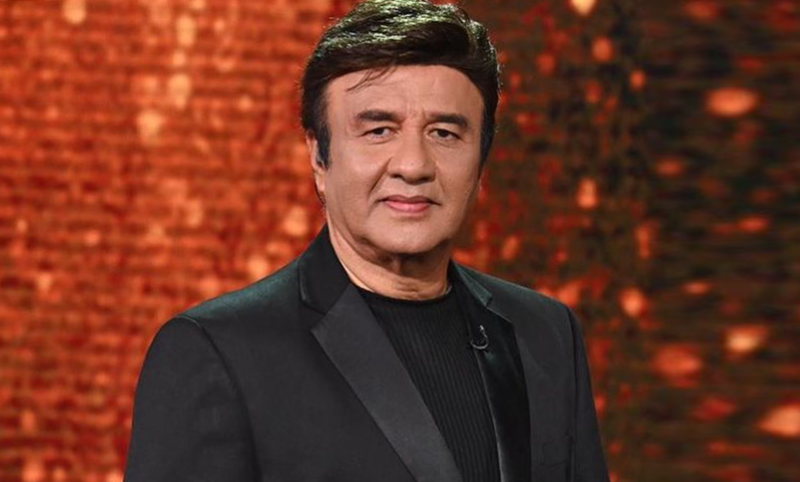
Celebrities With Allegations
ALOK NATH
NANA PATEKAR
MJ AKBAR
BIRJU MAHARAJ
ANU MALIK

Slide 13

Casting Couch
Casting-couch mentality is the demanding of sexual favours by an employer or person in a position of power and authority, from an apprentice employee, or subordinate to a superior in return for entry into an occupation, or for other career advancement within an organization.
GET READY FOR THE AUDITION OF A LIFETIME

Slide 14
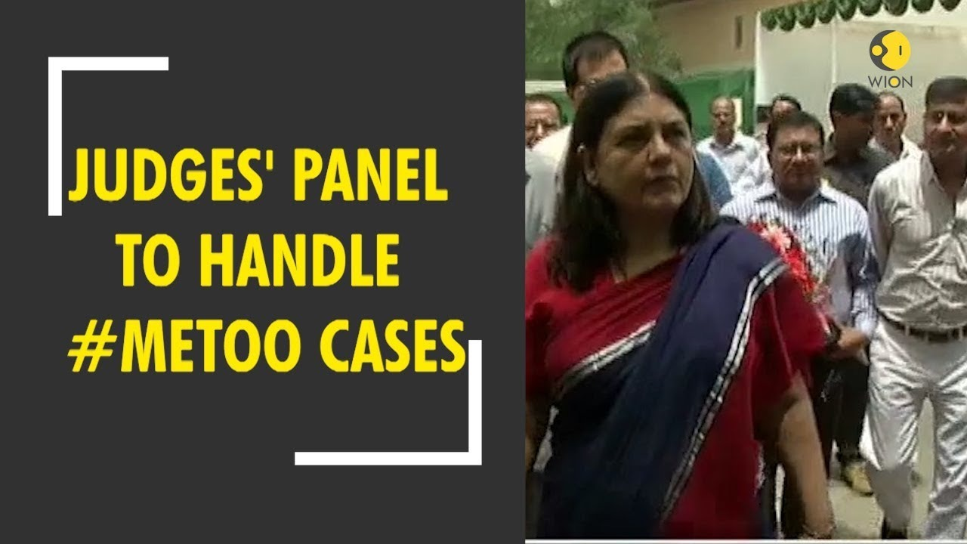
Steps By Government
Former Union Minister for Women and Child Development Maneka Gandhi assured of setting up a committee to look into the issues that are coming out of the #MeToo movement.

Slide 15
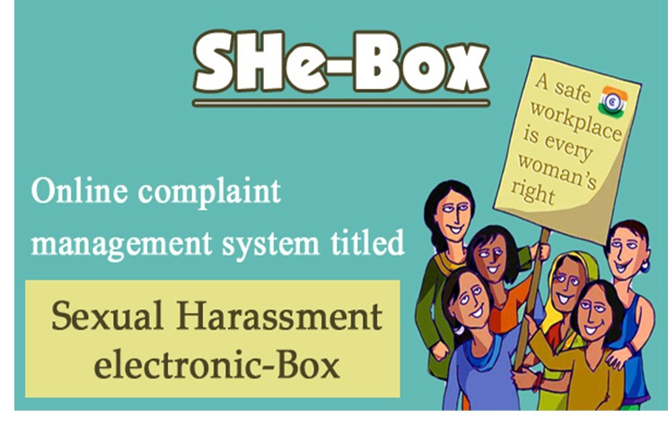
Steps By Government
WCD launched comprehensive She-Box (sexual harassment e-box) online complaint Management System for women to lodge complaints of sexual harassment at workplace.

Slide 16
Steps By Government
Strict directions were issued for all organizations towards the right implementation of POSH Act.
Prevention of Sexual Harassment is a law, as the name suggests, was brought in to protect women from any harassment at work along with providing a safe, non-discriminatory environment within their workplaces.

Slide 17
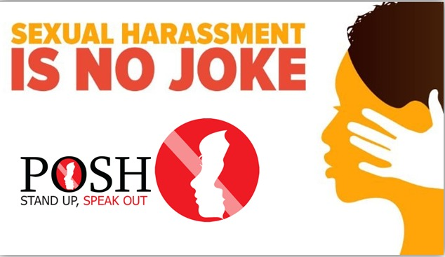

Slide 18
Positive Impacts
This movement empowered the women to form a community and help each other in talking about the bitter truths of sexual abuse in the world.
It raised awareness among women about their rights as an individual in the work place or outside and made men understand the consequences of the same.
This has helped bringing out the buried truth about Harvey Weinstein and many other men like him and brought them to justice in the eyes of the world.

Slide 19
MeToo’s Dark side
The biggest backlash is of fake accusation where a woman will falsely accuse a high profile man of sexual misconduct. Some women are using this movement as a "bargaining chip" to get what they want either a position or money.
In January 2021, Indore police registered a rape case after a 19-year-old girl alleging her tenant with metoo but later admitted she did this for compensation from government.
Many have pointed to a lack of representation of minority women in the #MeToo movement even though minority women are more likely to be targets of sexual harassment.

Slide 20
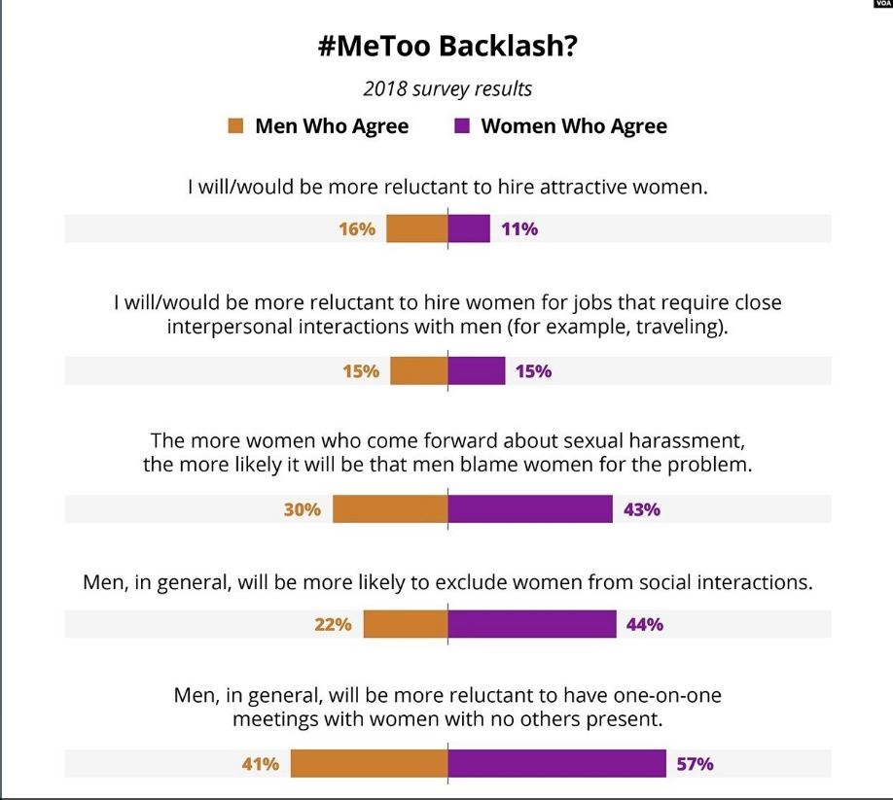

Slide 21
TIME’S UP Movement
Time’s Up shares a similar vision for women’s empowerment with #MeToo. Time’s Up can be thought of as an action-oriented step in the #Metoo movement.
It was started by a group of over 300 women in Hollywood, in 2018, with high-profile leaders in response to the Weinstein effect and the Me Too movement.
The organization’s aim is to create concrete change, leading to safety and equity in the workplace and to raise money to support victims of sexual harassment.

Slide 22
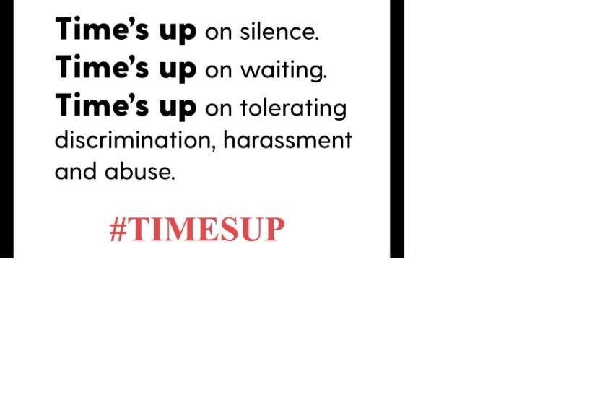

Slide 23
What Needs To Be done
Have an anti-harassment policy and ensure all employees sign up to it
Zero tolerance policy should be there against sexual harassment in organizations regardless of an employee’s stature.
Implementing incorporate training on harassment and discriminatory treatment at workplace
Our ancient values and morals should be added in education curriculum.

Slide 24
From #WhyMe to #MeToo
This world has turned beautiful and strong

Slide 25


Slide 26

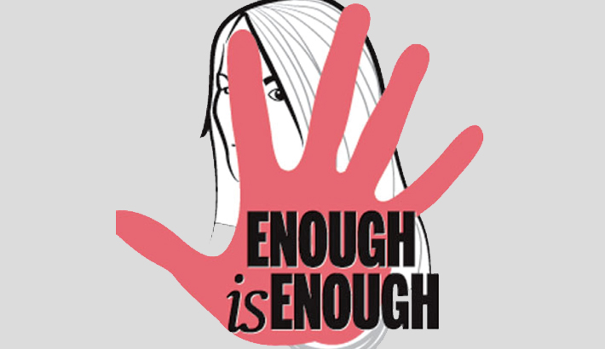
CONCLUSION
The main success of Me Too movement is that it taught many people that it’s not their fault to be a sexual abuse victim. It started shaming offenders instead of victims. It is a big step towards reducing violence against women. Though some people are misusing the movement, this can be solved with a proper legal procedure. Behavioural change is needed to further reduce these kind of crimes.
NO MEANS NO
MAY BE MEANS NO
SILENCE MEANS NO
ONLY YES MEANS YES

Slide 27
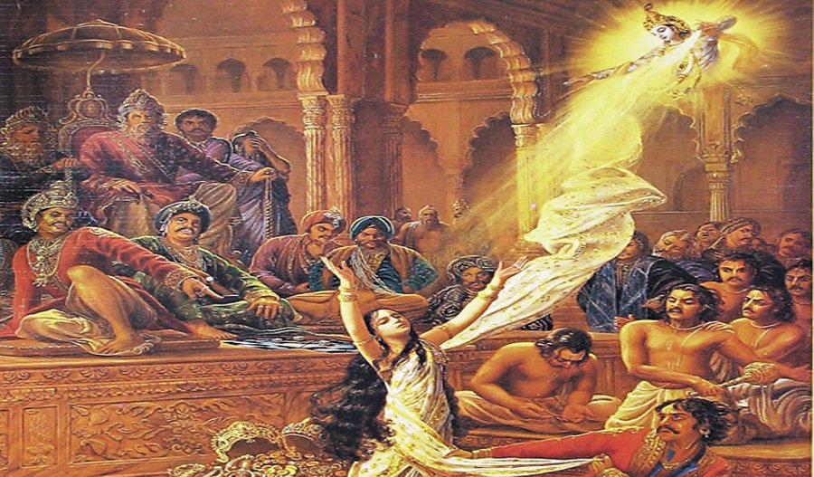
सुनो द्रोपदी शस्त्र उठालो, अब गोविंद ना आयेंगे!

Slide 28
REFERENCES
https://vinciworks.com/blog/ten-steps-to-preventing-sexual-harassment-in-your-workplace/
https://www.jatinverma.org/me-too-campaign-pros-and-cons
https://www.quora.com/What-are-the-pros-and-cons-of-the-MeToo-movement
https://www.forbes.com/sites/karlynborysenko/2020/02/12/the-dark-side-of-metoo-what-happens-when-men-are-falsely-accused/
https://www.forbes.com/sites/karlynborysenko/2020/02/12/the-dark-side-of-metoo-what-happens-when-men-are-falsely-accused/?sh=173af9e8864d
https://blog.ipleaders.in/metoo-movement-implementation-posh-law/
https://en.wikipedia.org/wiki/MeToo_movement

Slide 29
REFERENCES
https://indianexpress.com/article/india/pm-modi-nhrc-delhi-metoo-mj-akbar-women-safety-triple-talaq-sexual-harassment-5399509/
https://indianexpress.com/article/india/metoo-narendra-modi-mj-akbar-maenka-gandhi-wcd-ministry-5400078/
https://economictimes.indiatimes.com/magazines/panache/metoo-anu-malik-finally-responds-to-sexual-harassment-allegations-says-he-may-take-legal
action/articleshow/72069358.cms?from=mdr
https://www.google.com/search?q=womehood&rlz=1C1CHBF_enIN969IN969&oq=womehood&aqs=chrome..69i57j0i10i433l2j0i10l7.2856j0j7&sourceid=chrome&ie=UTF-8
https://www.google.com/search?q=%23Sanskaari+actor+in+film+industry&rlz=1C1CHBF_enIN969IN969&oq=%23Sanskaari+actor+in+film+industry&aqs=chrome..69i57j0i546.9593j0j7&sourceid=chrome&ie=UTF-8

Slide 30


